Slide 1
Phase 3 Deliverable
Group 3.2

Slide 2
Index
Brainstorming
Sketching - Affinity groups
Task walkthrough
Storyboard
HealthEat LoFi prototype overview

Slide 3
GENERAL Brainstorming
Discussion about which should be the main screens
5 Sketches of each screen
Individual elements were discussed and analysed
Final versions of screens were made from best elements of each sketch.

Slide 4
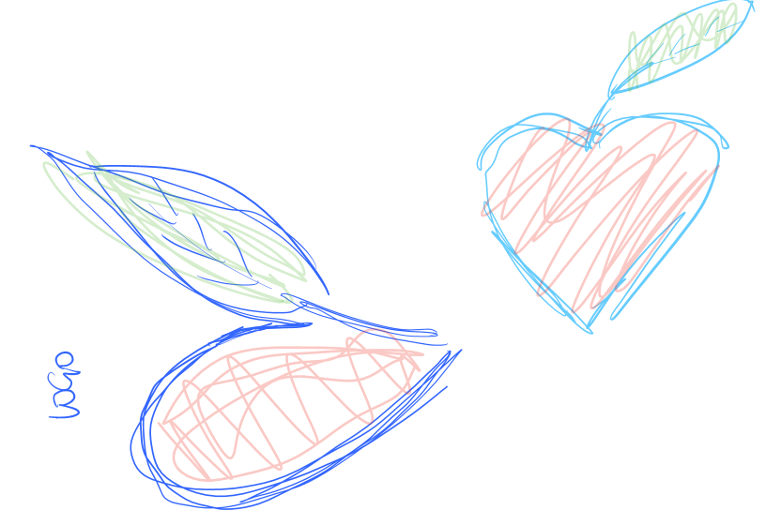

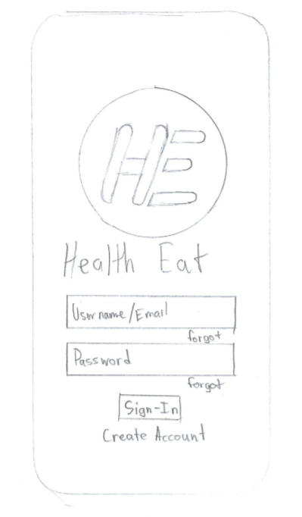
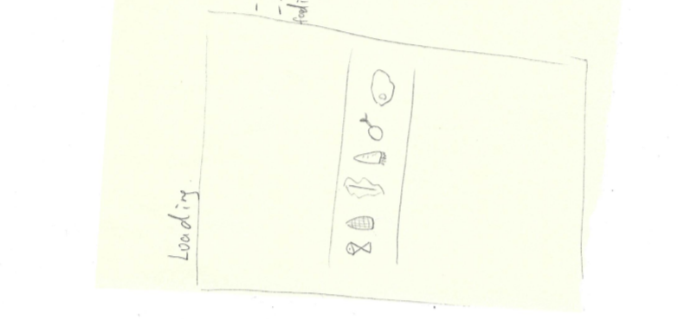
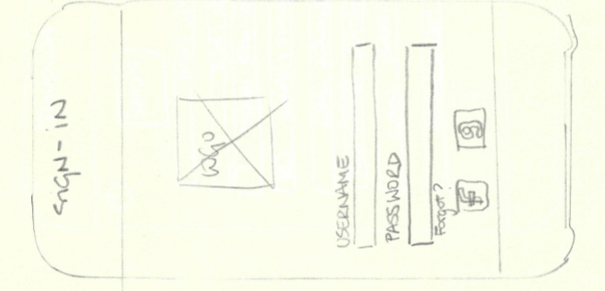
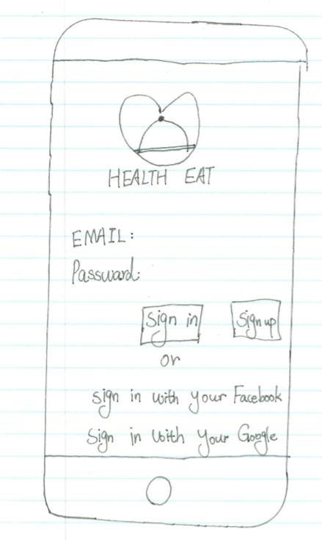
Affinity Group - Log In / Sign-up

Slide 5
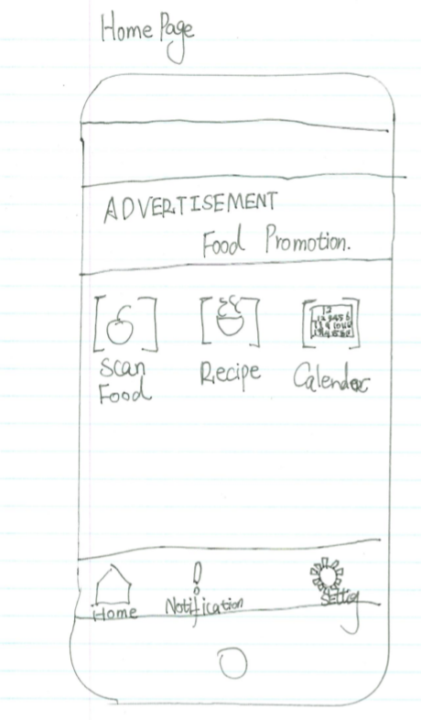
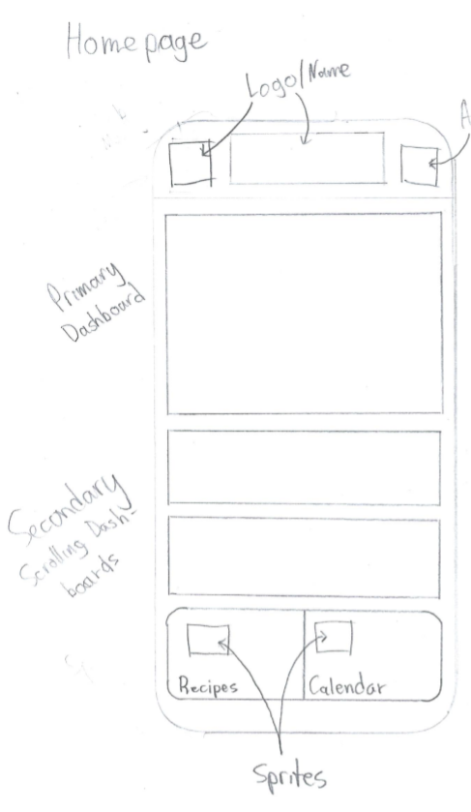
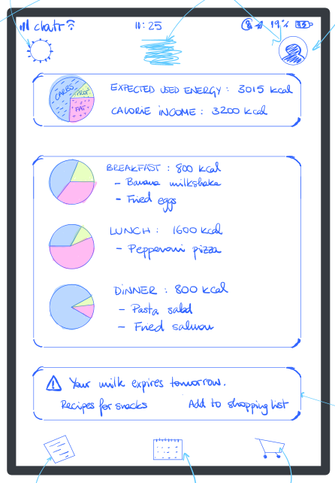
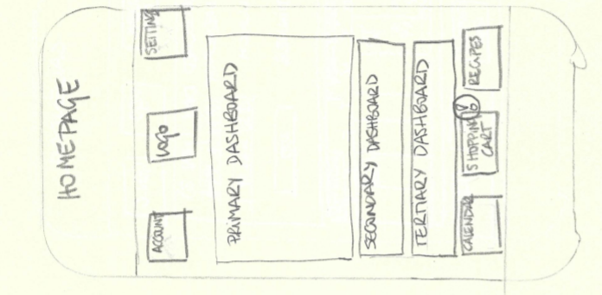
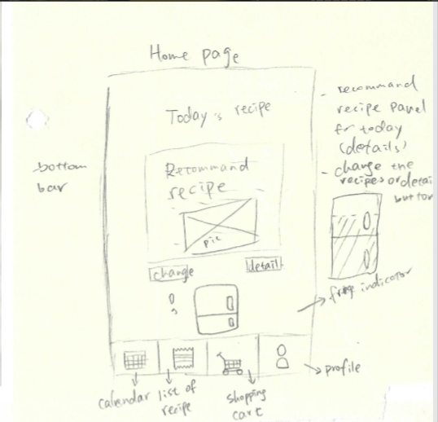
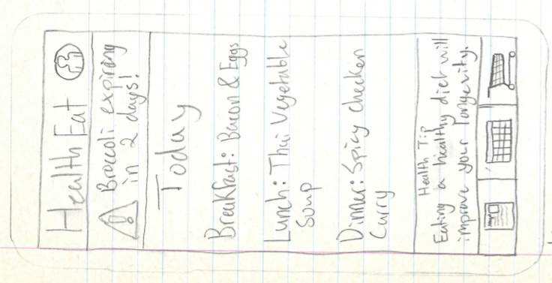
Affinity Group - Homepage

Slide 6
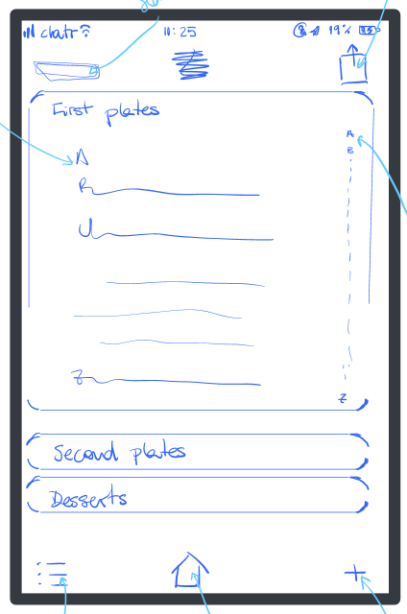
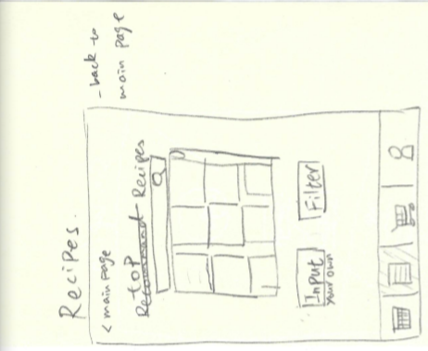
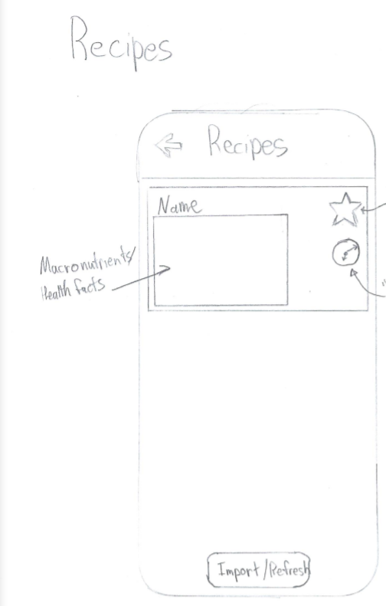
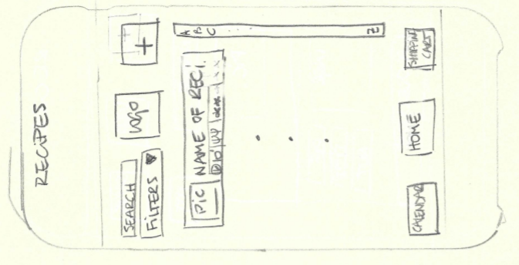
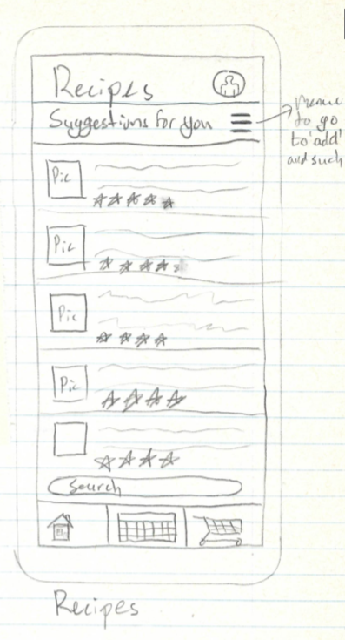
Affinity Group - Recipes

Slide 7
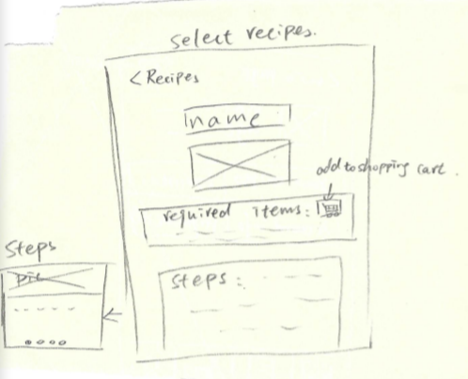
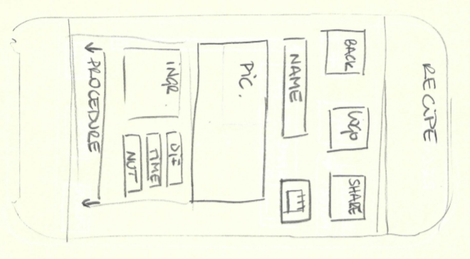
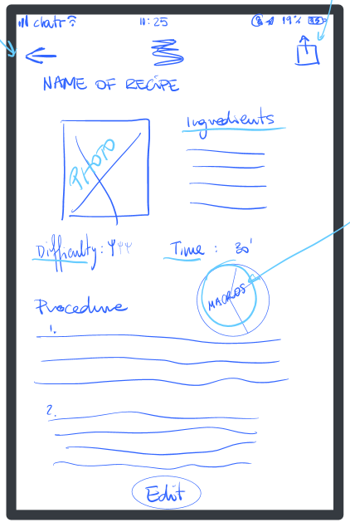
Affinity Group - Recipe Details

Slide 8
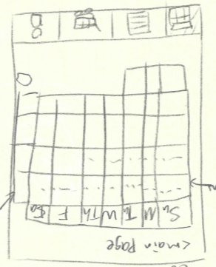
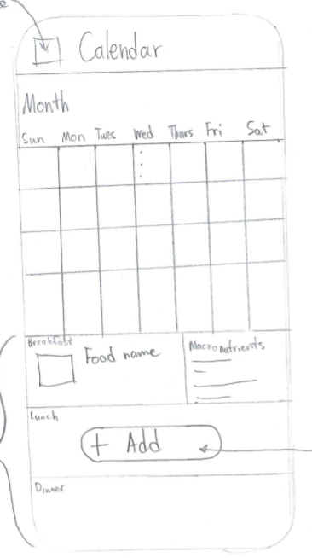
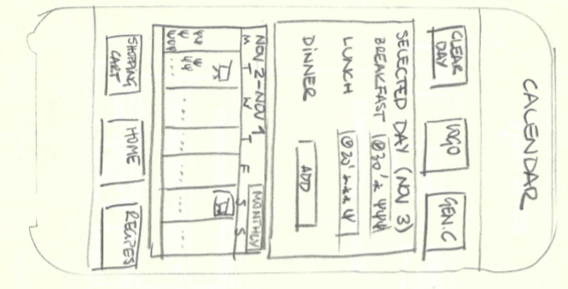
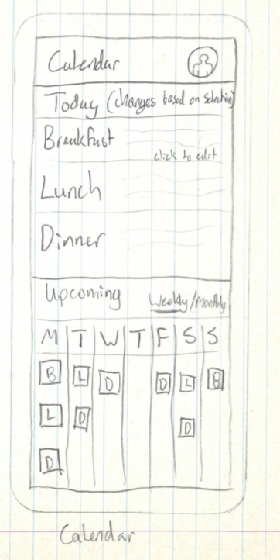
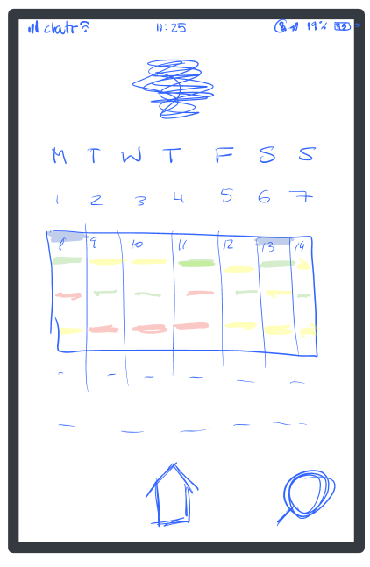
Affinity Group - Calendar

Slide 9
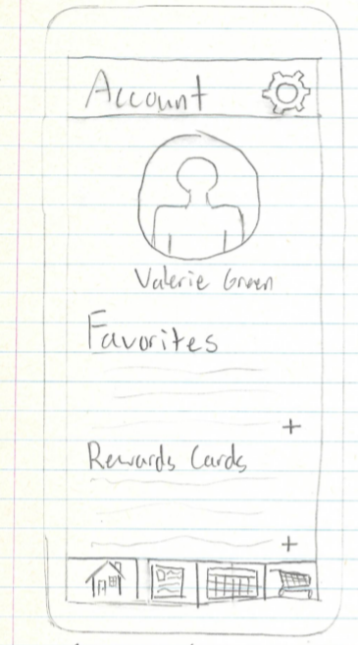
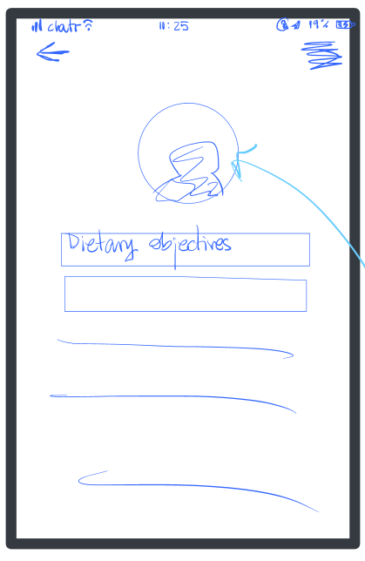
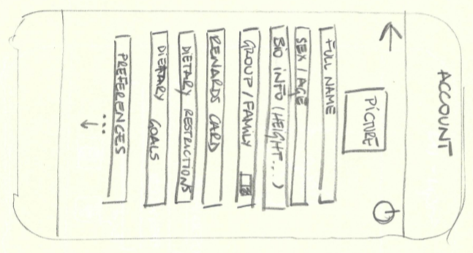
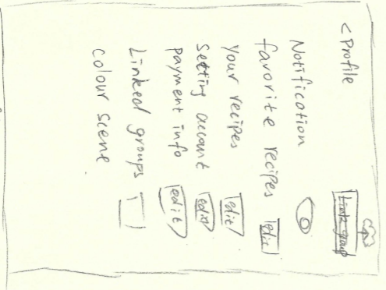
Affinity Group - Settings/Account Info

Slide 10
Task Description 1a: Create profile
Description of Step | Does the user have the knowledge/training to do this step? | It is believable that they would do it? That is, are they motivated? | Comments (Including possible solution)
Get the mobile phone and download the app | Yes. Apps are downloaded routinely | They want the app so it is believable | We could make the app pre-installed in the system
Create an account inputting name, email and password | Yes. Accounts are created routinely when downloading apps | They want a healthier diet and use this application so yes. | We could provide options like sign up with your google account.
Input sex, age, height and weight. | Yes. | They want the app keep track of their information | Explain the differences in the diet of a man, woman or kid
Scan rewards card and payment card | Yes. | Yes but they could be wary about sharing that information | Short description about how the application uses the rewards card information

Slide 11
Task Description 1b: Create profile
Description of Step | Does the user have the knowledge/training to do this step? | It is believable that they would do it? That is, are they motivated? | Comments (Including possible solution)
Input dietary objectives (calorie intake, macro distribution) | Yes, input objectives is straightforward. | It’s another step of the profile creation walkthrough | People are uneducated usually in these topics. WHO recommendations as predetermined.
Add personal info regarding food allergies and dietary restrictions. | Yes, add personal info regarding food allergies is straightforward | Yes | The app could propose the most common allergies and illnesses (i.e. Diabetes) and include a search bar. Skip button available.
Include family/group | Yes, include family group info is easy | Yes | 3 columns for age, sex and dietary restriction of extra

Slide 12
Task Description 2a: Add Recipe to Calendar
Description of Step | Does the user have the knowledge/training to do this step? | It is believable that they would do it? That is, are they motivated? | Comments (Including possible solution)
Buy food in person from store | Yes | Yes | Can also order online through the app
Open HealthEat and go to in-app Fridge to view groceries | Yes, a notification will be shown to the user indicating an update to their fridge | Yes, to make sure the app has all their new food items | If the user bought a food item from a a store not linked to their rewards card they can manually enter it in the fridge
Go to Recipes page and view suggested Recipes | Yes, a notification will be shown that there are new suggested recipes | Yes, they want to see the apps suggestions | -

Slide 13
Task Description 2b: Add Recipe to Calendar
Description of Step | Does the user have the knowledge/training to do this step? | It is believable that they would do it? That is, are they motivated? | Comments (Including possible solution)
Select a recipe to view details | Yes, if a recipe looks appealing the user can click it to view more details | Yes | -
Select the Add button on the recipe of choice | Yes, if they like a recipe they will want to Add it to their plan | Yes | This will open up the Calendar page
Select which day and meal you’d like to schedule the meal | Yes, the Calendar will be shown. User just chooses the day and meal | Yes | -

Slide 14
Task Description 3: Edit calendar
Description of Step | Does the user have the knowledge/training to do this step? | It is believable that they would do it? That is, are they motivated? | Comments (Including possible solution)
Click calendar in homepage | Yes | Yes, they want to check what’s their meal-plan for the week | -
Click edit calendar button | Yes, Clicking a button is straightforward. | The user wants to change the food the algorithm proposes, so yes | -
Make choices (i.e. no sugar, spicy, bulking week, etc.) | The user would have some preprogrammed options | Yes | Search bar in case the user has something specific in mind. If that’s not in the app a suggestion option could added
Click generate button | Again, it’s straightforward | Yes | -

Slide 15
Task Description 4: Add family member
Description of Step | Does the user have the knowledge/training to do this step? | It is believable that they would do it? That is, are they motivated? | Comments (Including possible solution)
Click Account in Homepage | Yes | The user wants to add a family member, so yes | -
Activate Family sharing | Yes, the users are used to do it in their own systems preferences and other apps. | The user wants to add a family member, so yes | -
Click Add a family member | It’s the first option that the user sees. If it’s the first time they do it, it will be easy. | Yes | -
Insert new member’s username and confirm. | Again, it’s straightforward | Yes | A small tutorial of these little tasks could be added when creating the profile in a HiFi version

Slide 16
Task Description 5: Logout
Description of Step | Does the user have the knowledge/training to do this step? | It is believable that they would do it? That is, are they motivated? | Comments (Including possible solution)
Click in Settings in Homepage | Yes | The user wants to logout so yes | -
Click the Power symbol | Yes, it’s straightforward | The user wants to logout, so yes | -

Slide 17
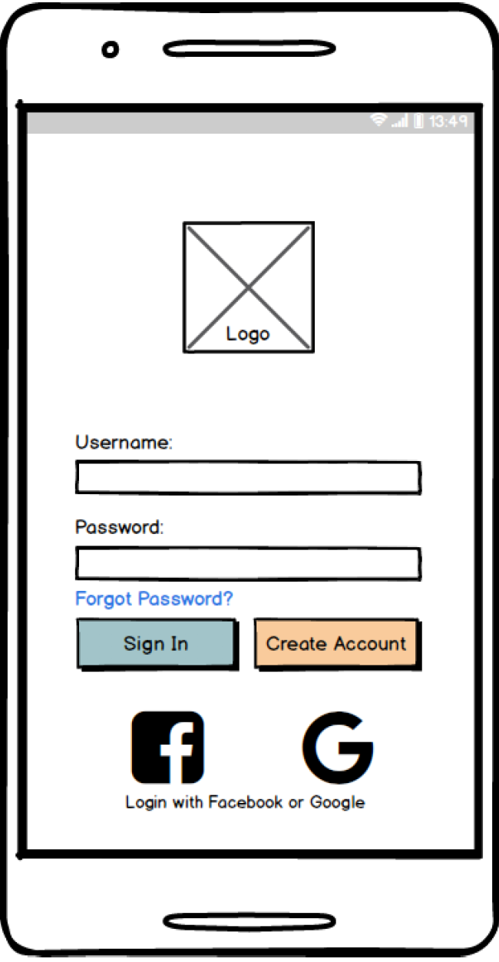
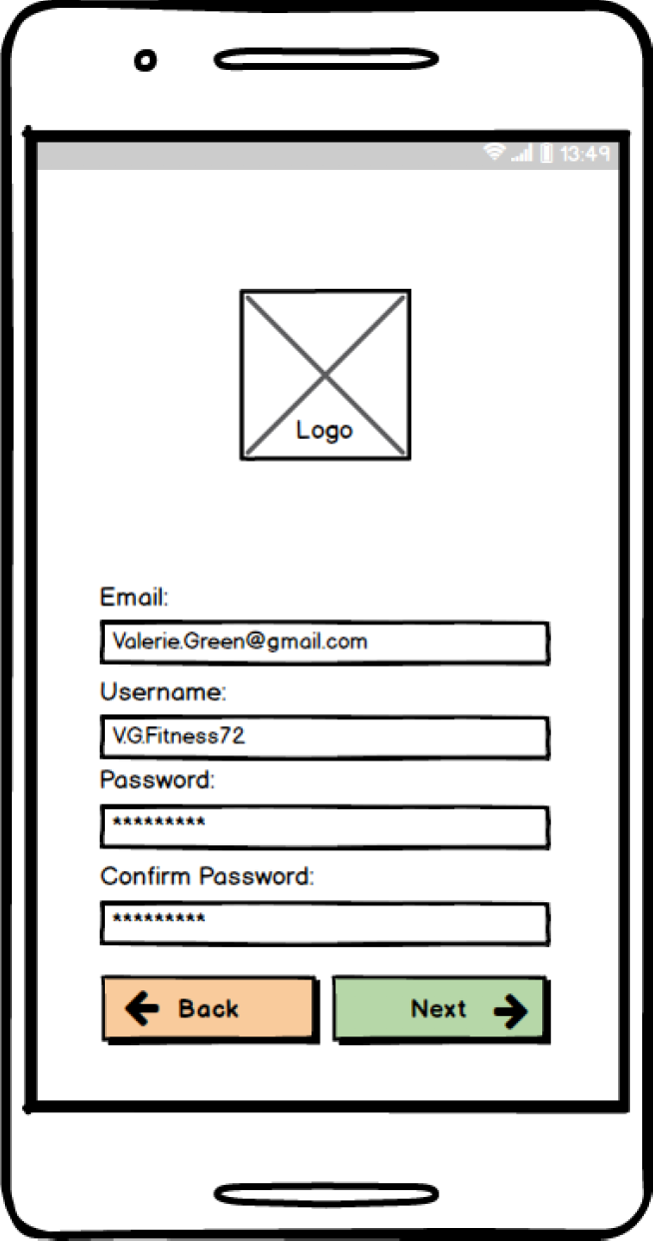
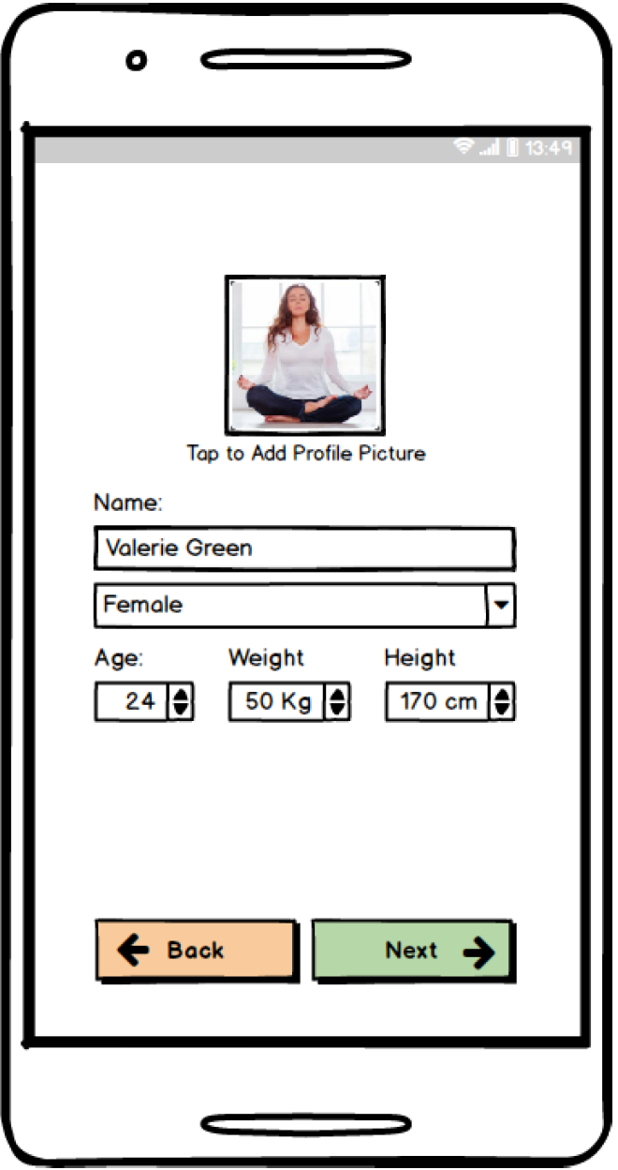
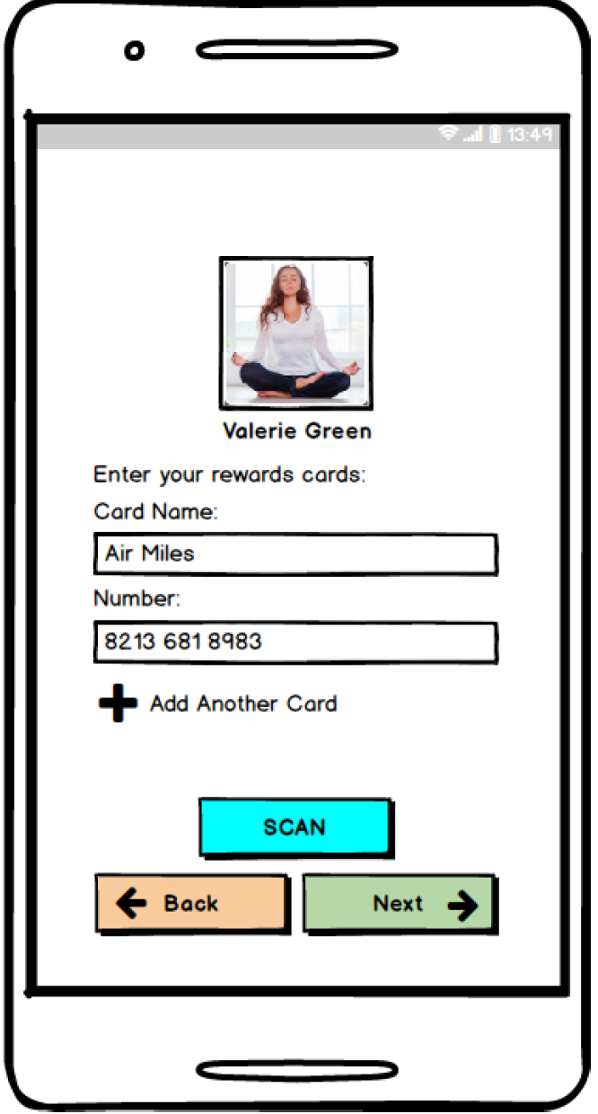
STORYBOARD

Slide 18
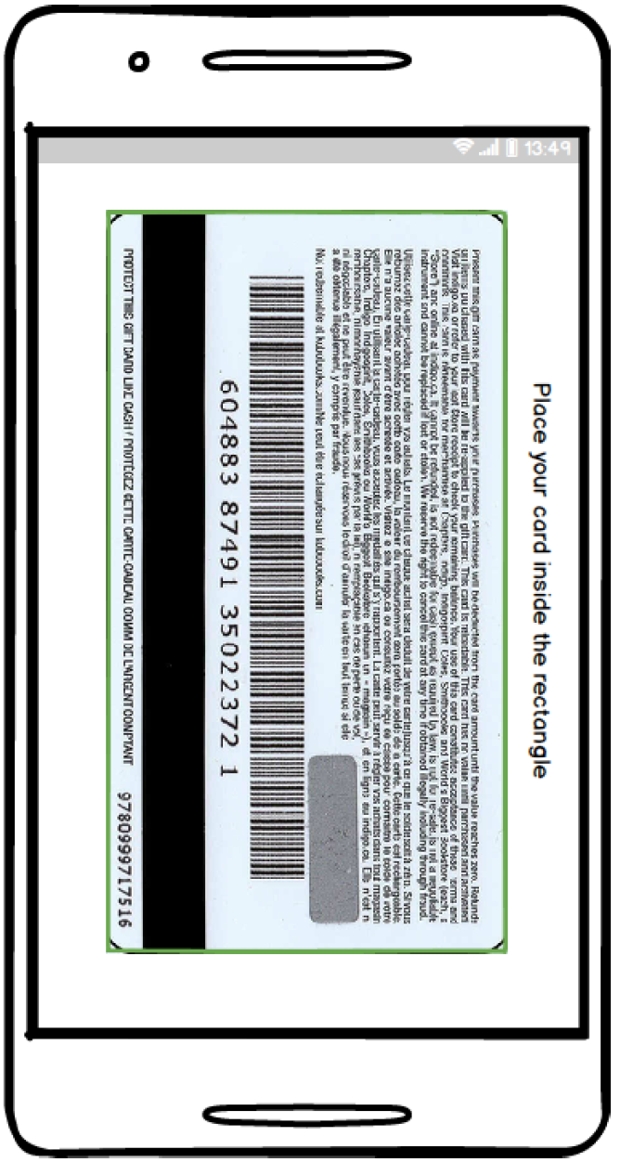
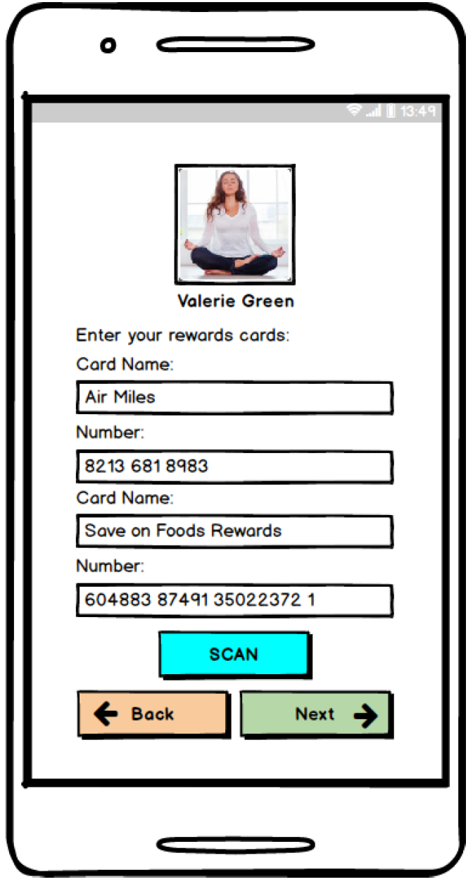
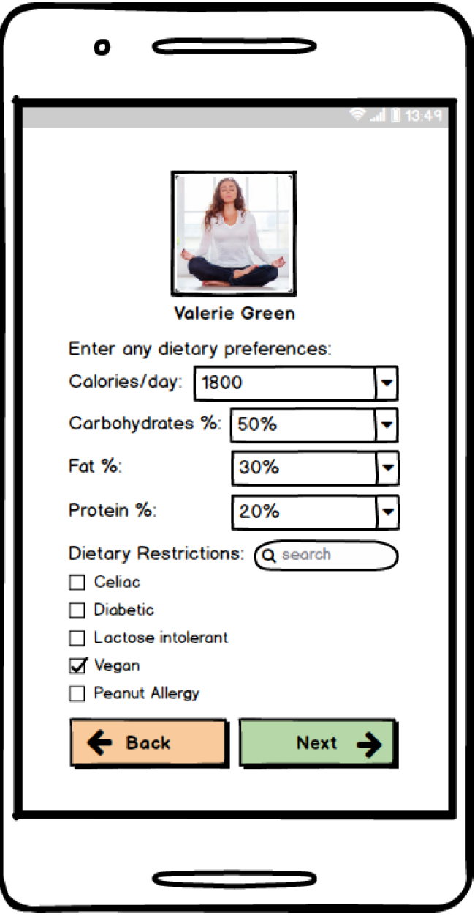
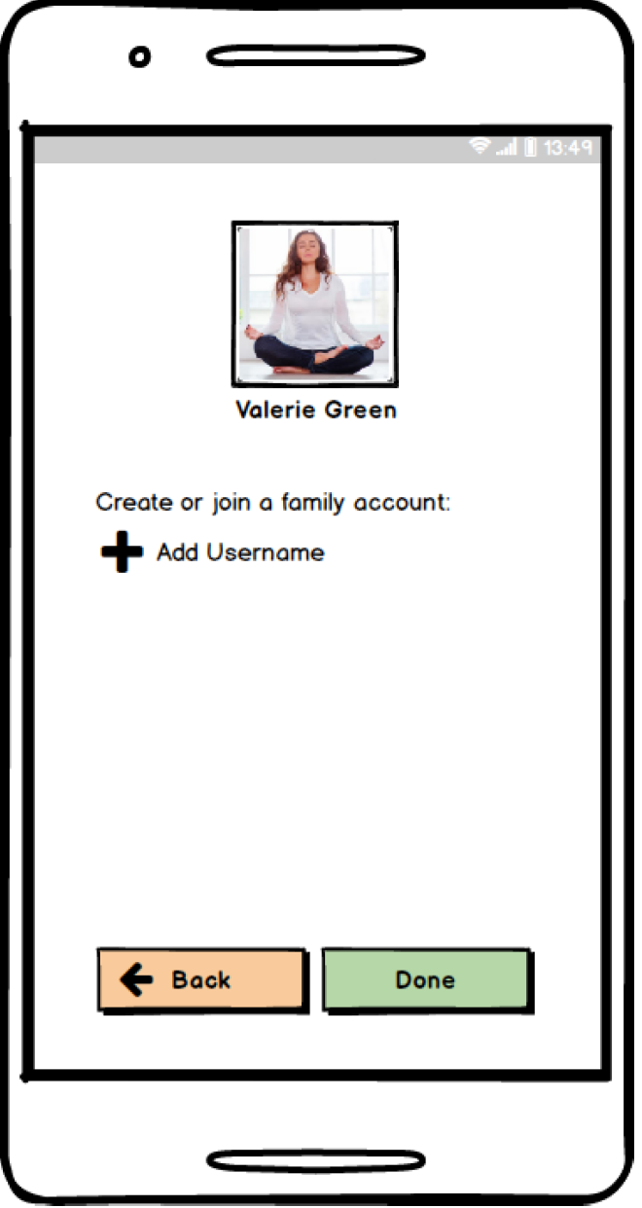
STORYBOARD

Slide 19
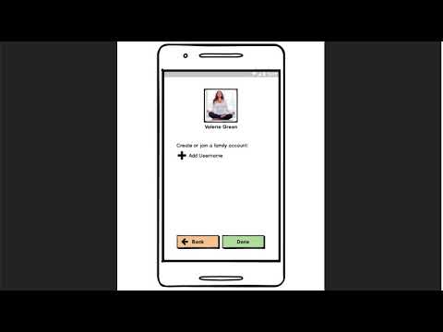
HealthEat LoFi Prototype overview
Main tasks:
Account creation
Add recipe to the calendar
Edit calendar with filters
Add family member
Log-out
https://youtu.be/A1Lts34EpkY

Slide 20
Reflection Paragraph
We decided together (after a brainstorming session) which would be the main pages of our app, then each of us made our own sketch of the page before our next meeting. The visualization of these pages were different for every one of us, which allowed us to pick different elements from each for our final design. The affinity grouping was a bit confusing to do since they all had the same core ideas, we spent a lot of time trying to figure out what exactly to do at this step, but after talking to the TA we were able to move forward.
The task walkthrough was done with the final sketches of each main page in mind and helped to develop a close to reality video overview and storyboard. Next time we would try to do less discussion before sketching so we would get more unique designs although the discussion before made sure we covered the important pages and had lots of sketches.

Slide 21
APPENDIX: Sketching images
https://christianmok.github.io/481TEAM/#sketching

